Slide 1

Dispatcher Architecture
Implemented in x86-64
By Michael Almandeel

Slide 2
Memory Structure
Physical Memory
The kernel is loaded at boot time starting at the beginning of the physical address space
The virtual address to physical address mappings of the kernel memory that every page table contains are identical for all process’s page tables
Users cannot access these kernel pages due to a protection key associated with each hop in the table, which is set to privileged
Kernel Space User Space
Virtual Memory
Kernel Space PID = 2
same mappings
different mappings
Virtual Memory
Kernel Space PID = 1263

Slide 3
Page Tables
Pid = 5
Pid = 632
A page table comprises up to 5 levels, where fewer levels indicate a larger page size
Each process’s page table has a unique page table index(stored in %cr3)
The page table index is identical to the associated process’s Pid
Shared kernel pages cannot be swapped to disk, they must reference the same physical addresses in ram at all times
Kernel pages exclusive to the user(i.e., buffers) may be swapped to disk
V_Addr:
0 – 600mb
Pk = 0
V_Addr:
600mb - ?
Pk = 3
V_Addr:
0 – 600mb
Pk = 0
V_Addr:
600mb - ?
Pk = 3
Kernel Space PID = 632 PID = 5
Physical Memory

Slide 4
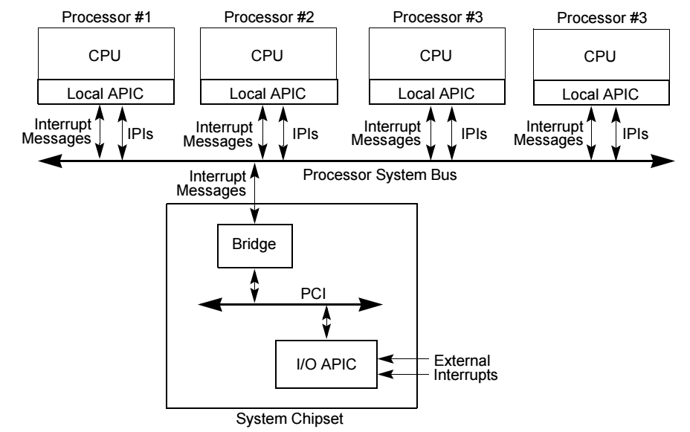
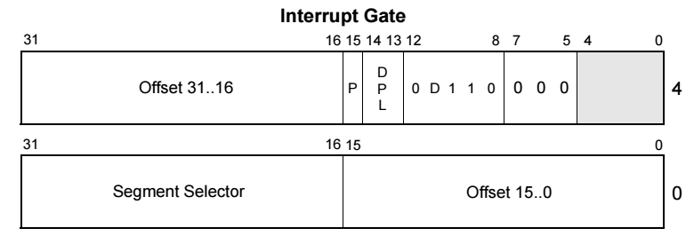
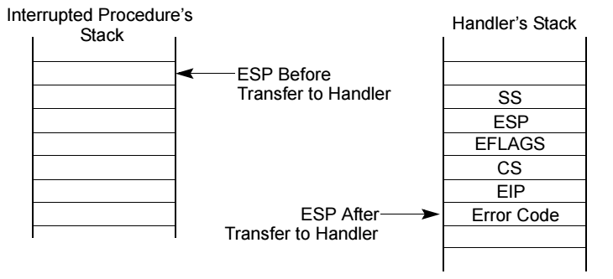
Interrupts
Interrupts are delivered to a core via its own local apic (advanced programmable interrupt controller)
When an interrupt occurs, the vector(index) is looked up in the IDT(an array)
Each IDT entry contains an Interrupt gate which contains the isr’s entry point in kernel space
Execution critical registers (%rip,%rsp,%rflags) are pushed to the kernel stack before isr execution
Earlier series CPUs push segment registers too(now obsolete)

Slide 5
Interrupts, Continued
Interrupts execute in privileged mode by default
2 Kinds of interrupts: maskable and non-maskable(NMI’s)
An NMI cannot be interrupted
A maskable interrupt can only be interrupted by an NMI
Interrupts are assigned a priority level , which the local apic uses to order their delivery to the core
An isr will run uninterrupted(except by an NMI) until it executes IRETQ
IRETQ restores the registers it previously pushed on the kernel stack and jumps to the user address where they were initially interrupted, while also signaling to the local apic that NMI’s and maskable interrupts are reenabled

Slide 6

A Simple Dispatcher
The dispatcher context switches from the currently running process to the next process, after it’s burst time has expired
A context is a set containing each register’s state for an executing program at a specific point in its execution
The virtual address space switch occurs immediately after the page table index is overwritten
Once state is restored, we initialize the timer to burst time, finally passing control to the restored process.
apic
apic
kernel
interrupt
kernel
pcb’s
pcb’s
timer isr
set timer
dispatcher
vas switch
dispatcher
%cr3 = 5
context switch
%cr3 = 631
save
restore
protection key: 0
protection key: 0
user
IRETQ
%rip
interrupt
%rip
user
protection key: 3
protection key: 3

Slide 7
Simple Dispatcher Continued
To dispatch a task, we set the timer on the local apic to burst time, and utilize the isr associated with the timer interrupt to jump into the entry point of the dispatcher when burst time has expired(or you can simply make the dispatcher the timer isr)
A context switch entails saving the state(registers) of the currently running process to it’s pcb and restoring the state of the pcb that corresponds to the first task on the ready queue. Changing %cr3 causes us to transition to the new process’s address space on the next instruction
We pass control by first copying the register values initially pushed onto the kernel stack by the timer isr to their corresponding entries in the preceding task’s pcb, and replacing them in the stack with their corresponding values in the current pcb, and call IRETQ, as if the dispatcher is the timer isr(it can be)

Slide 8
Problems
When a process is interrupted, the resulting isr hijacks it’s burst time
No way to deliver interrupts that are intended for a specific process

Slide 9
Burst Time Management - Overview
When a task is interrupted the resulting isr hijacks the task’s burst time
We need to pause the timer during isr execution, and resume the timer just before the isr executes IRETQ
There is no mechanism to pause the timer, but we can cancel it by writing 0 to the initial count register in the local apic timer
We reset the timer right before restoring control to the interrupted task, setting the timer to (start_time + burst_time) - interrupted time
apic
kernel
set new timer
intr. n
jmp
Isr n
timestamp
burst time manager
IRETQ
intr.
user
%rip

Slide 10

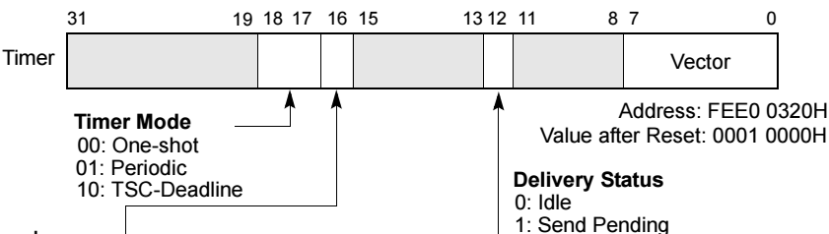
Burst Time Management - Implementation
We record interrupted_time at the initial entry point of every isr(except the timer) by pushing %rax and %rbx to the stack(to preserve their states), and executing the RDTSC instruction (this loads the current timestamp into %rax + %rbx)
We then push the timestamp and the remaining registers onto the stack
After that, the interrupting isr executes as usual
Finally, instead of executing IRETQ, the isr jumps to the entry point of the burst time manager
The burst time manager uses the timestamp to calculate the new value for the timer
It pops all saved registers , restoring their state, and sets the timer right before finishing the state restore by calling IRETQ, being careful to not pop %rflags, %rsp and %rip(these are needed for IRETQ to restore execution context)
Timer Duration Settings
Timer Mode and Target Settings(LVT)

Slide 11
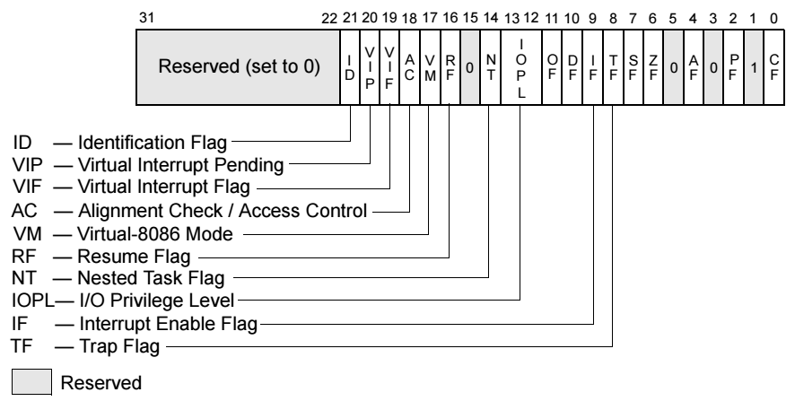
NMI Concerns
Since an NMI can interrupt the currently executing isr of a maskable interrupt, we can end up jumping into the burst time manager prematurely
In this case the interrupted isr will never be returned to , effectively causing the interrupt to be dropped altogether
Thankfully, the %rflags register of the interrupted program is in a predictable place in the stack
The IF flag indicates whether interrupts are enabled
If IF is 0, we have interrupted an isr, in which case we don’t push the timestamp or jump to the burst time manager
If IF is 1, we interrupted a task and proceed as normal
%eflags Register

Slide 12
Dispatching Targeted Interrupts
Interrupts are “dumb” in the sense that they merely signal that a certain type of action has occurred, without saying anything more about it
We must maintain shared queues so that originators of or isr’s for a given interrupt vector can store metadata about each specific interrupt occurrence
The metadata consists of a combination of a task id or a Pid, buffer address(es), flags, timestamps, state variables etc…
Each process has an area of memory reserved for a queue that contains the order of and metadata about the interrupts
Each process has an array of pointers to functions, similar to an IDT(one for each vector supported)
apic
timer isr
Isr n
interrupt manager
burst time mgr
task dispatcher
kernel space
interrupt queue
user space
user idt
interrupt dispatch stub
loop
user isr’s
jmp
%rip

Slide 13
Implementing Targeted Interrupts
After an isr services an interrupt, it jumps to the entry point of the interrupt manager instead of the burst time manager
The interrupt manager reads the metadata queue associated with the interrupt vector, and writes the metadata to a special area of memory all programs have called the interrupt queue
If the interrupt isn’t targeted at the current Pid, %cr3 is pushed and overwritten to perform a vas switch to write to the correct Pid’s interrupt queue. It then restores %cr3 and proceeds to the burst time manger
When a task is dispatched by the task dispatcher or restored by the burst time manager, it IRETQ’s to the interrupt dispatch stub unless the process is currently executing within the stub, in which case it restores state as normal

Slide 14
Interrupt Dispatch Stub
To avoid preempting a currently running handler, the dispatcher/burst time manager sets a ‘done’ variable in the user task to ‘0’ every time we IRETQ to the stub. The stub writes ‘1’ to the variable immediately before jumping to the stored program context
If done = 0, the dispatcher/burst time manager simply restores state normally, resuming the dispatch stub
In addition to setting ‘done’, the dispatcher/burst time manager writes the value of %rip(on the stack or pcb) to the operand of the final instruction in the stub, a jmp, before executing IRETQ
The stub code enters a loop which reads all outstanding entries in the interrupt queue, and uses the metadata to get the IDT index of its corresponding function pointer, which is called
When all entries are serviced, it sets the ‘done’ variable to ‘1’ and executes the jmp instruction to the address written by the dispatcher
After the jmp, the previously interrupted program resumes with its state correctly restored
task dispatcher
burst time mgr
iretq
iretq
interrupt dispatch stub
loop
done = 1
jmp %rip
get metadata
interrupt queue
resume task execution
return
get function
user isr
user idt
call

